Slide 1
Financial analysis of
s&p 500 stocks
By
Divyanshu Gangwar

Slide 2
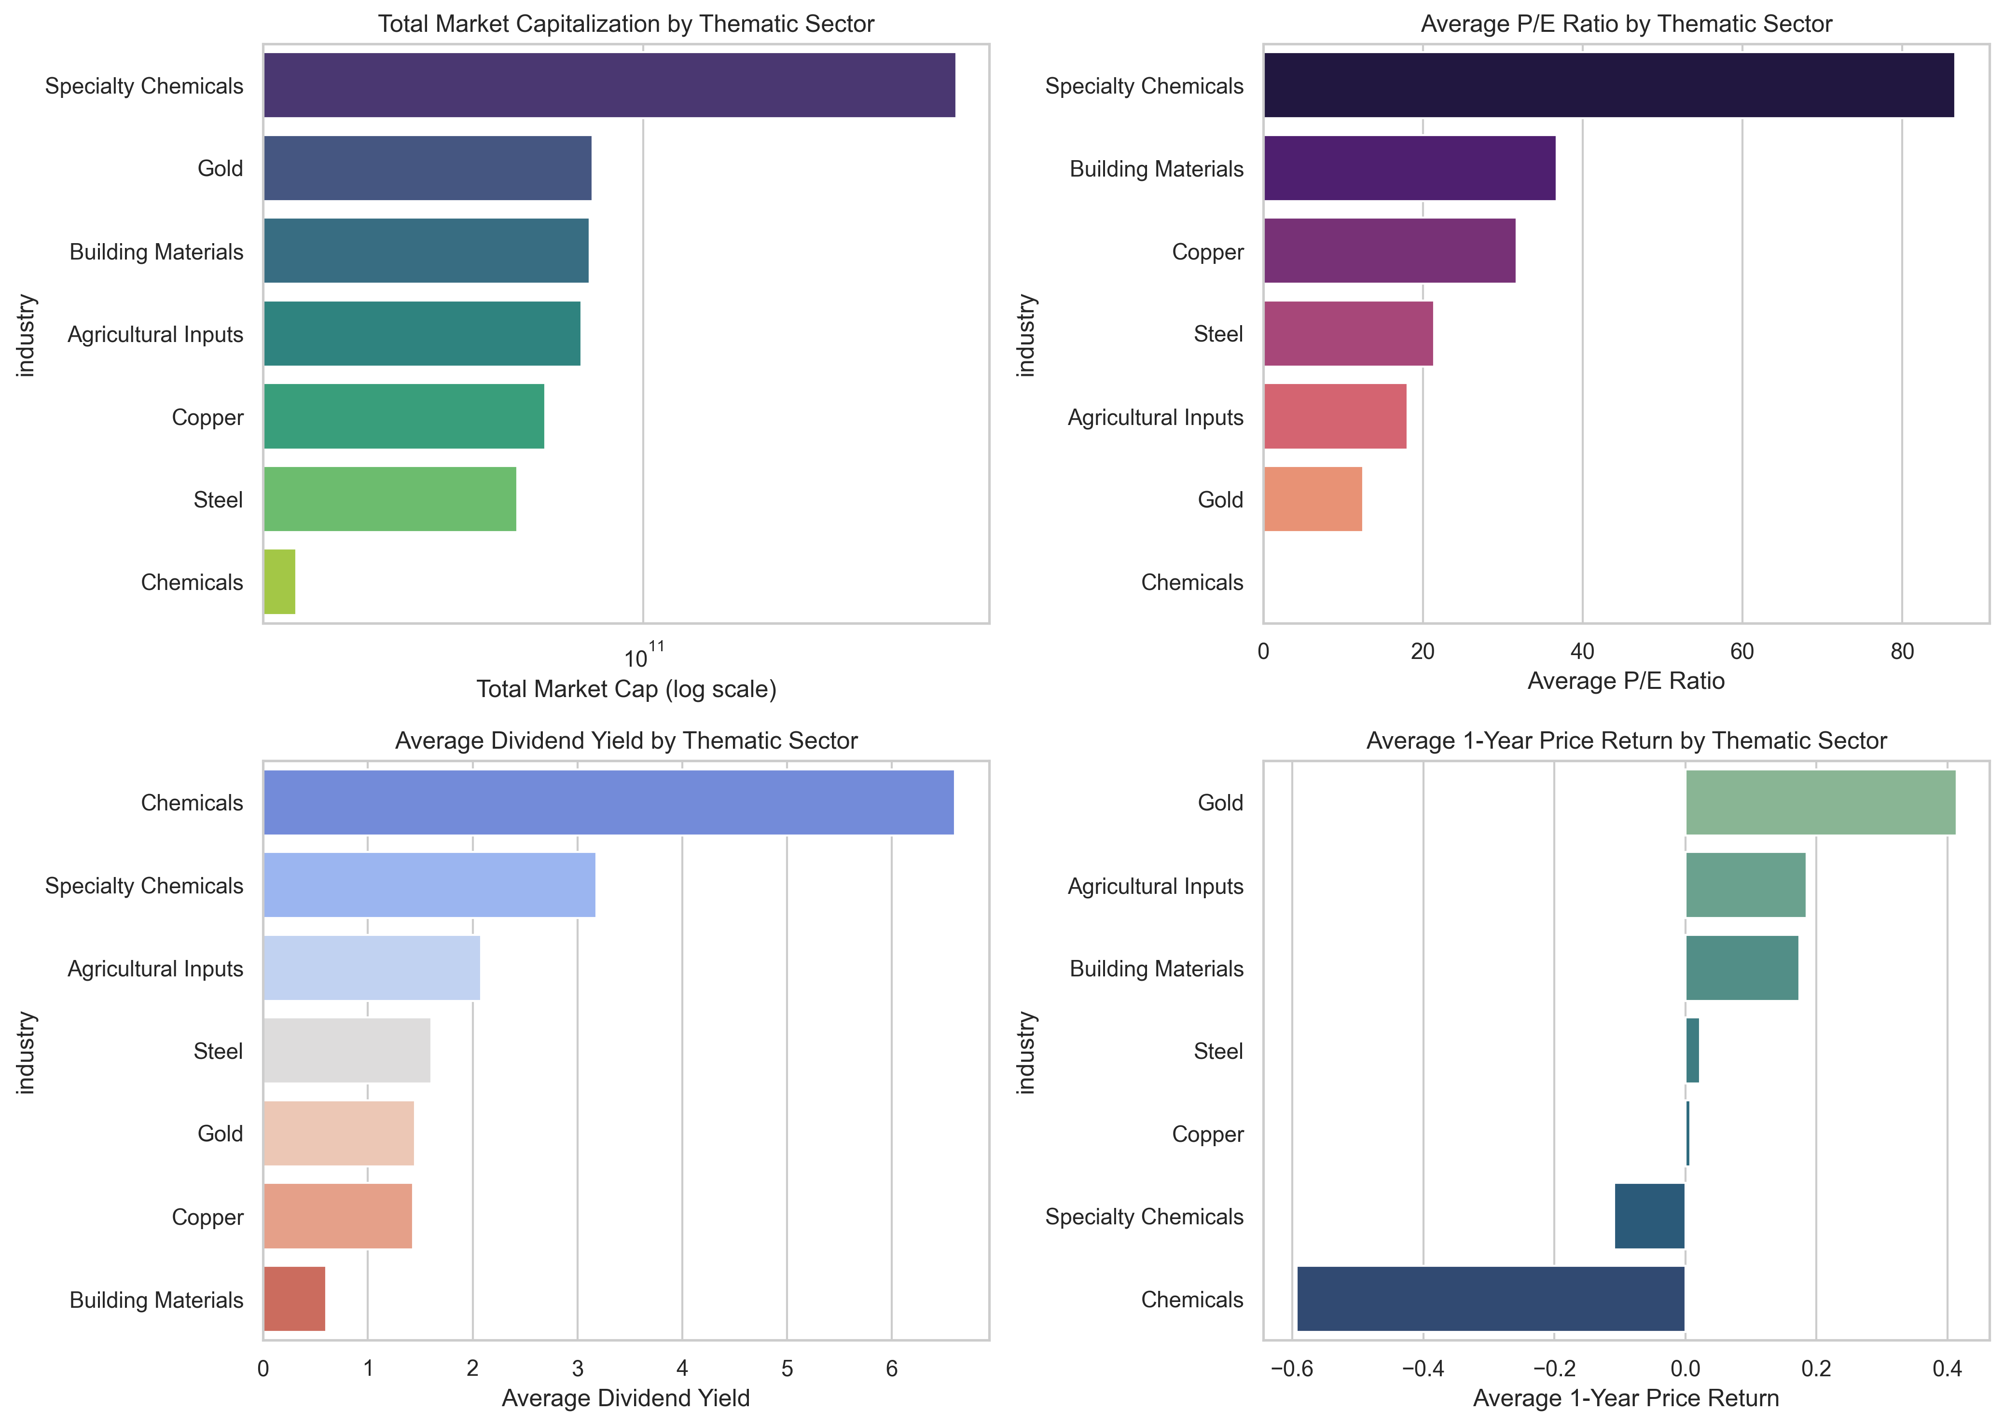
Basic Materials
Analysis
Specialty Chemicals lead with the highest market capitalization and P/E ratio (over 80), indicating strong growth expectations, but show a negative average 1-year price return.
Chemicals offer the highest dividend yield (around 6.5%) but have the lowest market cap and a negative price return of about -0.6.
Gold stands out with a high market cap, modest P/E ratio (~12), the lowest dividend yield (~1.5%), and the strongest positive 1-year price return (~0.42).
Building Materials, Agricultural Inputs, Copper, and Steel display moderate valuations and mixed price returns, balancing yield and growth prospects.

Slide 3
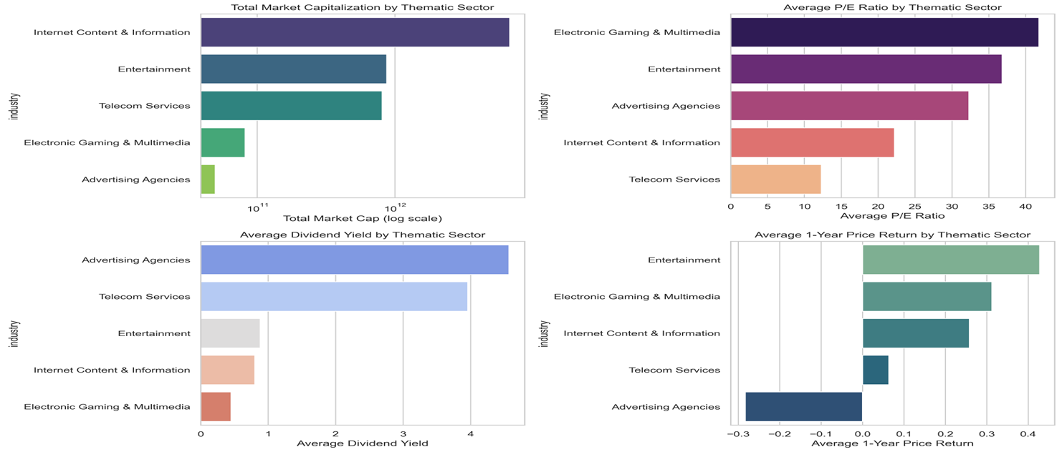
Communication Services
Analysis
"Internet Content & Information" leads in total market capitalization but has moderate P/E ratio and dividend yield, with a positive 1-year price return.
"Telecom Services" features a large market cap and high dividend yield but the lowest P/E ratio and modest price return.
"Electronic Gaming & Multimedia" has the highest P/E ratio but low market cap and dividend yield, with a strong price return.
"Advertising Agencies" show the lowest market cap and price return but the highest dividend yield.
"Entertainment" shows a strong P/E ratio and the highest 1-year price return but moderate market cap and low dividend yield

Slide 4
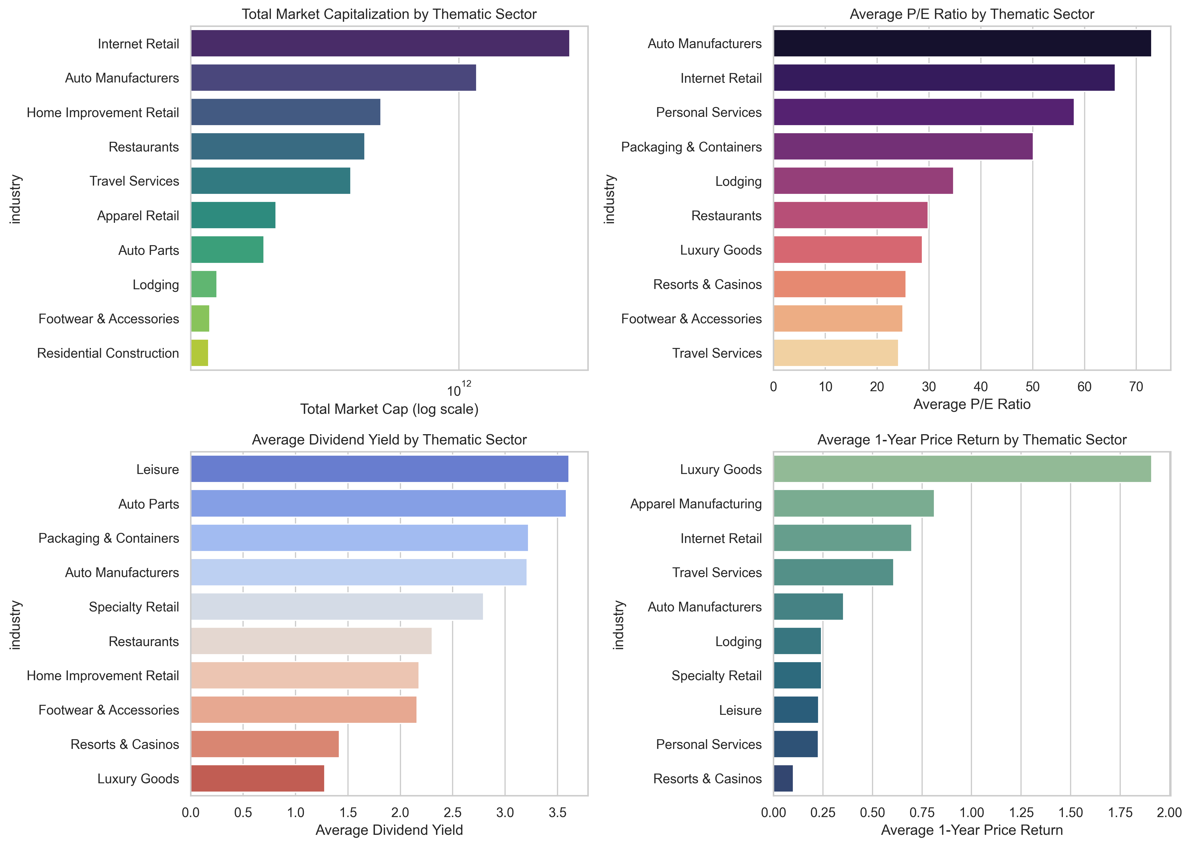
Consumer Cyclical
Analysis
Internet Retail leads in total market capitalization and has a high average P/E ratio, indicating strong growth expectations but offers moderate dividend yield and price returns.
Auto Manufacturers show significant market cap and the highest P/E ratio but provide solid dividend yields with modest price returns.
Luxury Goods have lower market cap but exhibit the highest 1-year price return despite a low dividend yield and moderate P/E ratio.
Leisure and Auto Parts sectors offer the highest dividend yields, while Resorts & Casinos display the lowest price return and moderate P/E ratio, suggesting cautious investor sentiment.

Slide 5
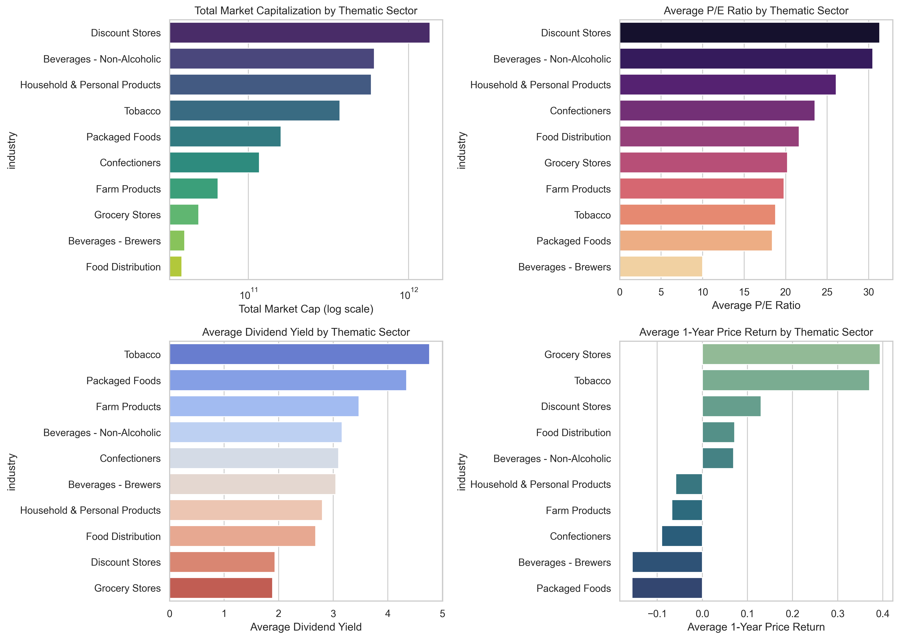
Consumer Defensive
Analysis
Discount Stores dominate total market capitalization and exhibit the highest average P/E ratio, indicating strong growth expectations. Despite their large size, they have a moderate dividend yield and modest price returns.
Tobacco, while smaller in market cap, offers the highest dividend yield but lower P/E and strong price returns.
Grocery Stores show high price returns but low market cap and dividend yield, suggesting potential undervaluation.
Brewers have the lowest P/E ratios and negative price returns despite moderate dividend yields, reflecting sector challenges

Slide 6
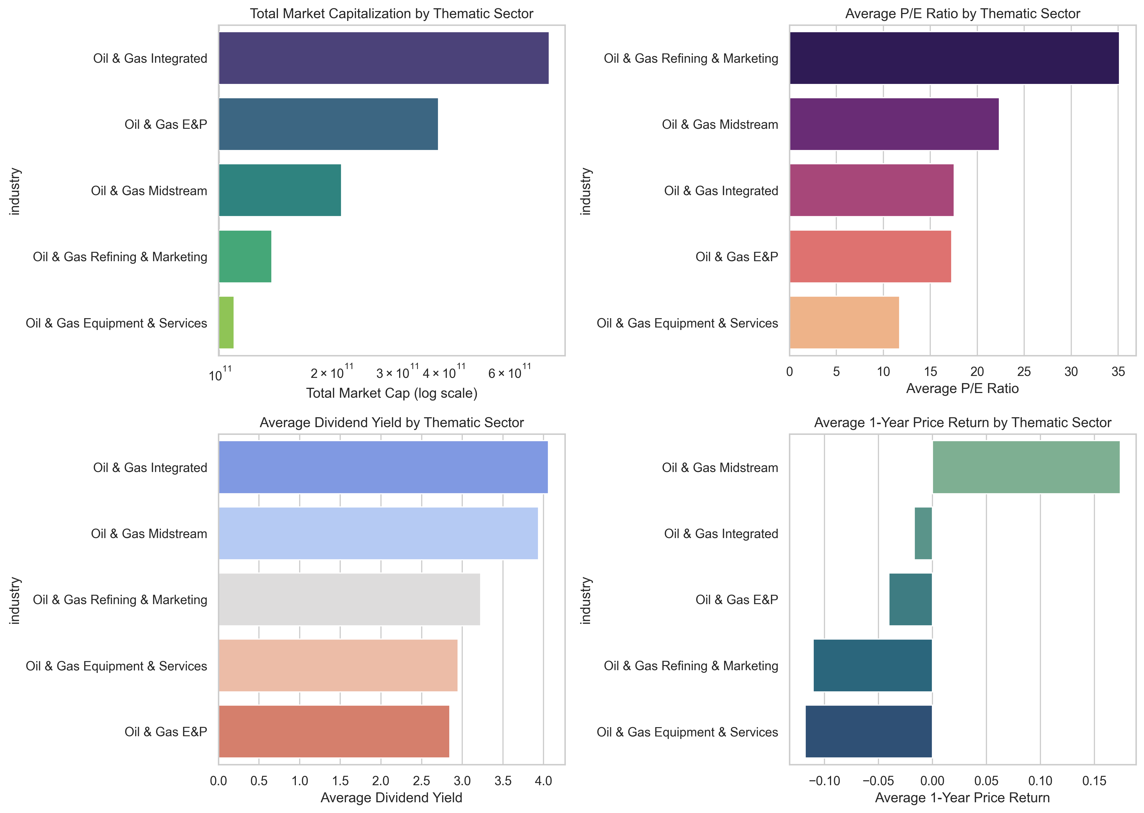
Energy
Analysis
The Oil & Gas Integrated sector leads in market capitalization and offers the highest dividend yield, indicating strong financial stability and shareholder returns.
Oil & Gas Midstream shows the highest 1-year price return and strong dividends, suggesting robust performance and investor appeal.
Oil & Gas Equipment & Services has the lowest P/E ratio and market cap, reflecting weak earnings expectations.
Oil & Gas Refining & Marketing has the highest P/E ratio but negative price return, hinting at overvaluation. Oil & Gas E&P displays mid-range metrics but negative returns, suggesting investor caution. Overall, Midstream stands out for balanced growth and yield.

Slide 7
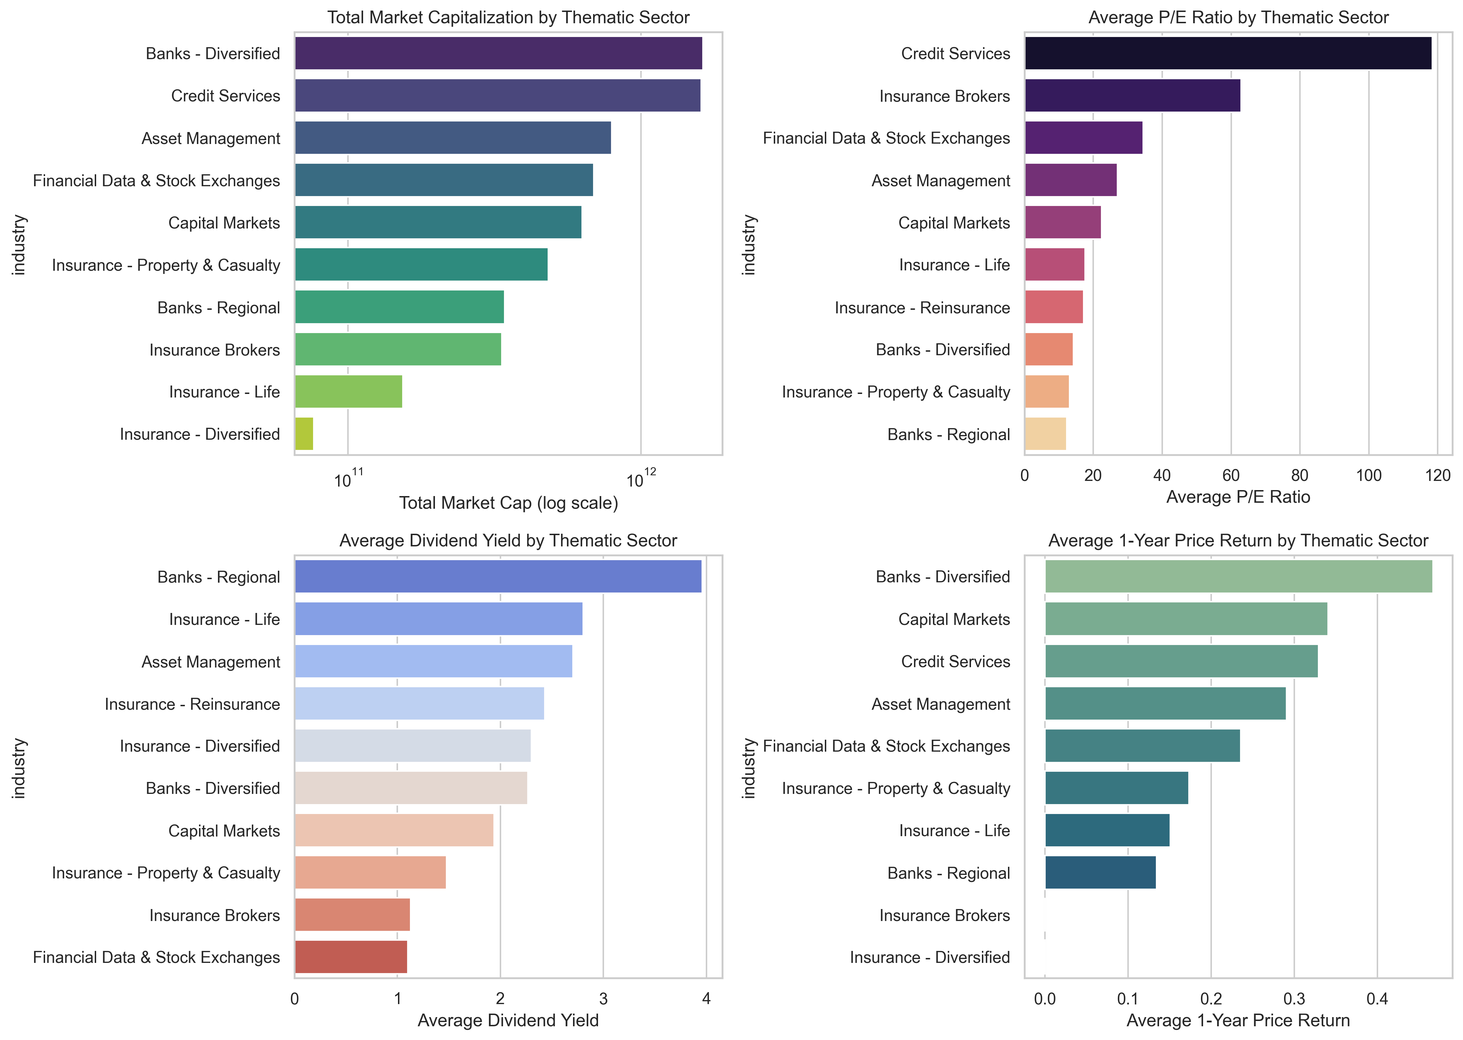
Financial Services
Analysis
Banks - Diversified leads in market cap and 1-year price return, indicating strong investor confidence.
Credit Services has the highest P/E ratio, suggesting high growth expectations, while "Banks - Regional" offers the highest dividend yield but the lowest P/E ratio and price return, pointing to a value-oriented, income-generating profile.
Insurance - Diversified consistently ranks low across all metrics, indicating weaker performance or investor interest.
Insurance Brokers show an unusually high P/E despite low dividend and price return..

Slide 8
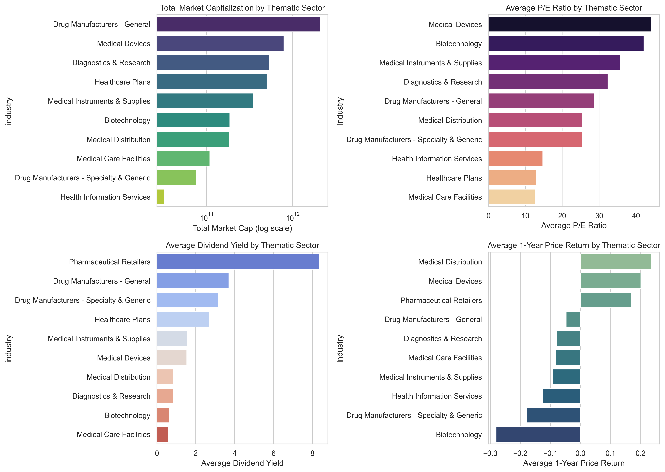
Healthcare
Analysis
The Drug Manufacturers - General lead in market cap but have moderate P/E ratios and dividend yields.
Medical Devices show high market cap, highest P/E ratios, and strong 1-year returns.
Pharmaceutical Retailers offer the highest dividend yield.
Biotechnology stands out with high P/E ratios but the worst 1-year returns.
Medical Distribution combines strong returns with a mid-tier market cap.
Medical Care Facilities consistently rank low across all metrics.

Slide 9
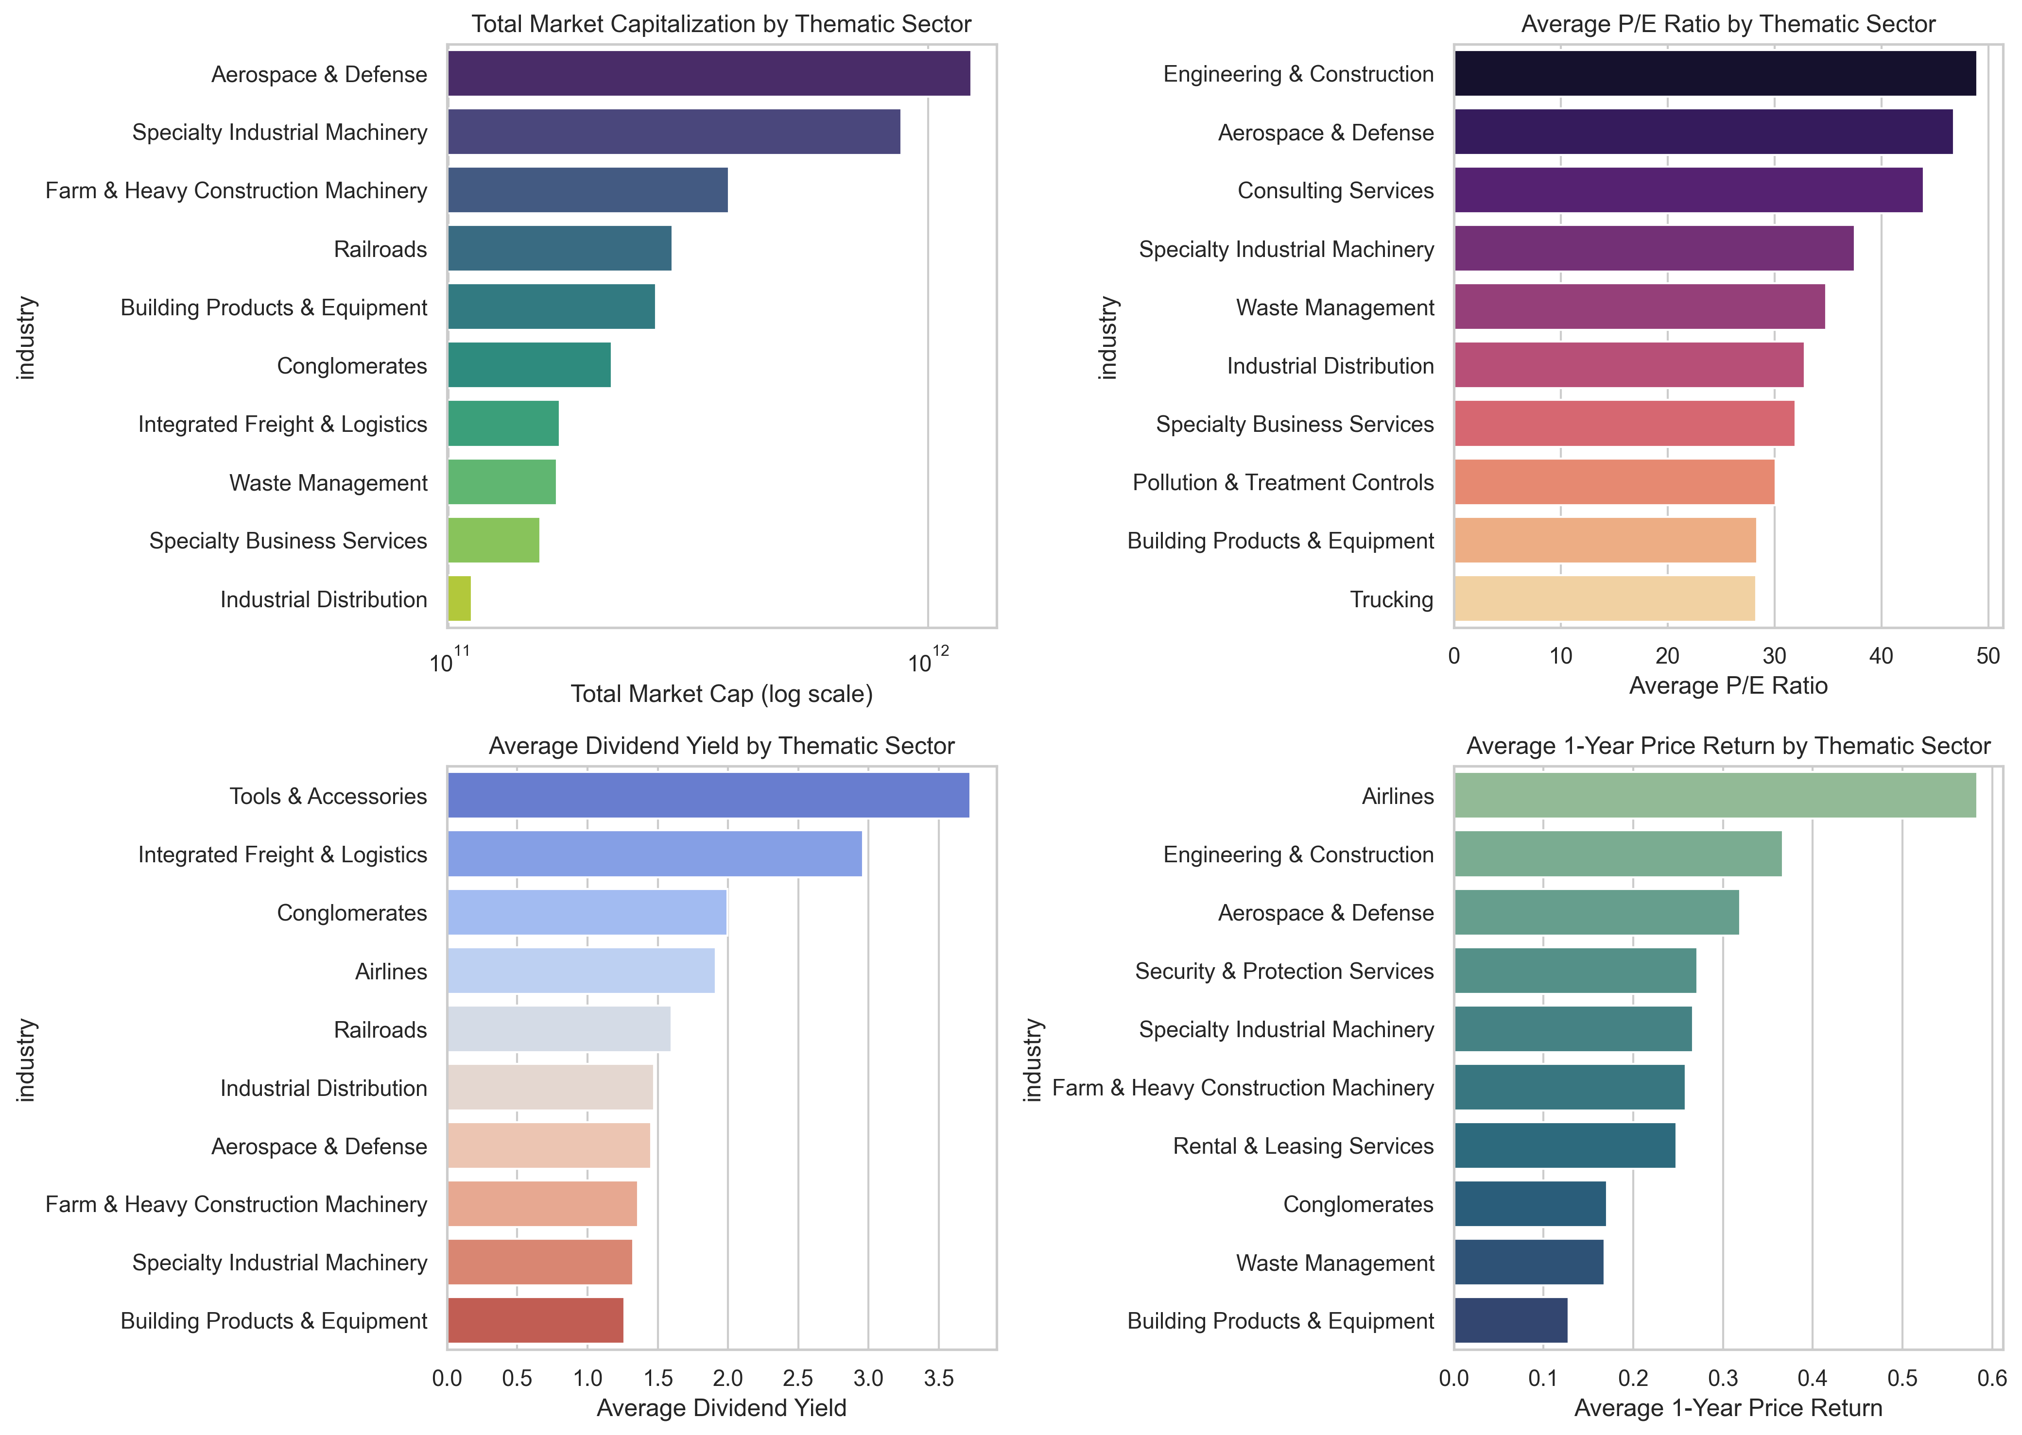
Industrials
Analysis
Aerospace & Defense leads in market capitalization and maintains strong P/E and 1-year returns, signaling robust investor confidence.
Engineering & Construction has the highest P/E ratio and strong price returns, indicating growth expectations.
Airlines show the highest 1-year price return despite mid-range dividend yield and no P/E data shown—suggesting a recent rebound.
Tools & Accessories and Integrated Freight & Logistics top dividend yields but aren’t prominent in other metrics.
Specialty Industrial Machinery consistently performs across metrics.
Waste Management has low market cap and price return but a relatively high P/E.

Slide 10
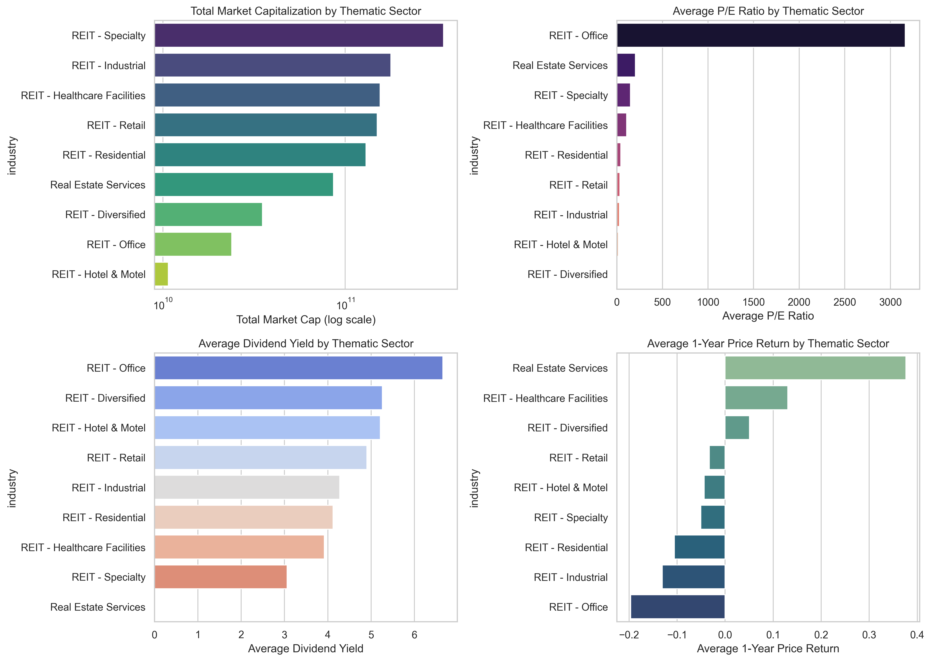
Real Estate
Analysis
Industrial, and Healthcare Facilities REITs dominate market capitalization.
Office REITs stand out with an exceptionally high average P/E ratio (~3000), suggesting distorted or negative earnings. They also offer the highest dividend yield (6%) but suffer the worst 1-year price return (-20%).
Real Estate Services has the best 1-year return (~35%) despite low dividend yield and modest market cap.
Diversified REITs offer a strong yield and moderate returns. Overall, high dividend yields often correspond with poor price performance, highlighting investor caution in underperforming sectors like Office and Hotel & Motel REITs.

Slide 11
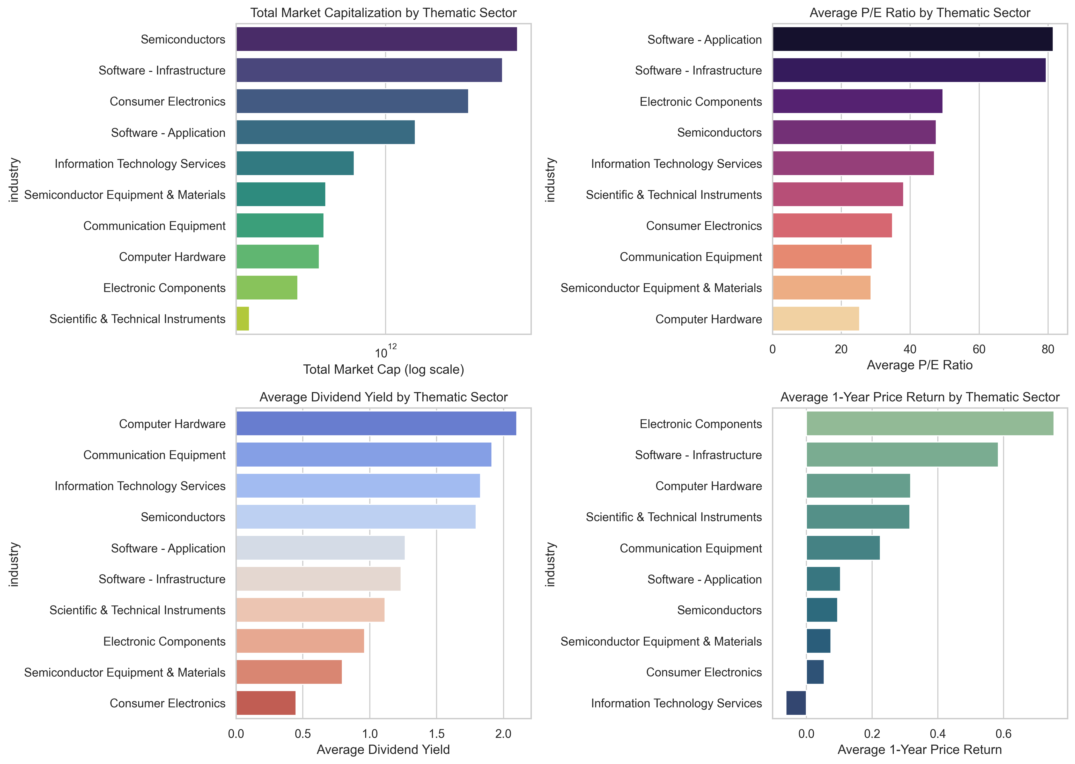
Technology
Analysis
Semiconductors lead in total market cap, while Software sectors dominate with the highest P/E ratios, suggesting strong growth expectations.
High valuations contrast with modest dividend yields, especially in Consumer Electronics, which has the lowest yield.
Computer Hardware stands out with the highest dividend yield and strong 1-year returns, indicating value appeal.
Electronic Components show the highest 1-year return despite lower market cap and yield.
Information Technology Services exhibit weak performance across returns and P/E, despite moderate market cap, signaling potential undervaluation or declining growth sentiment.

Slide 12
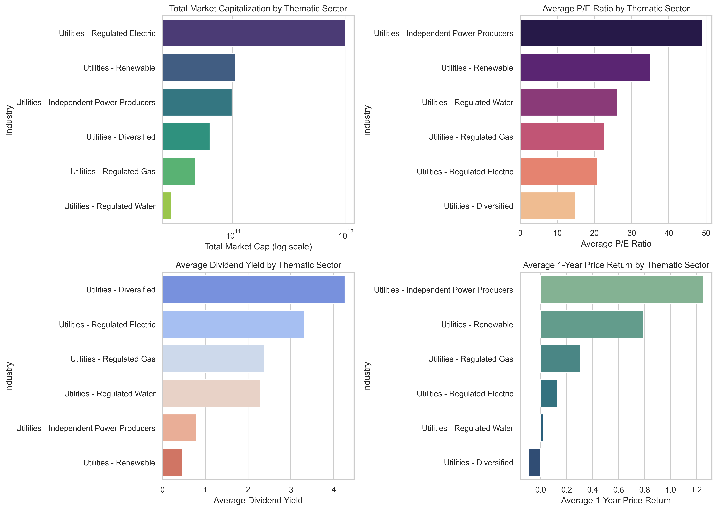
Utilities
Analysis
Regulated Electric holds the largest market cap., while Independent Power Producers lead in average P/E ratio (~47) and 1-year price return (~1.2), indicating strong growth expectations.
Renewable utilities also show high valuation and returns but offer the lowest dividend yields.
Diversified utilities provide the highest average dividend yield (~4.2%) but have the lowest P/E and 1-year return, suggesting income over growth.
Regulated sectors (Gas, Water, Electric) show moderate yields and valuations.

Slide 13
portfolio optimization

Slide 14
Technique
Reduce overall risk by balancing sector exposure
Instead of concentrating in volatile sectors, spread investment across sectors, giving more weight to those that are more stable (i.e., have lower average beta).
Favor efficient companies within sectors
Use profit margin as a proxy for operational efficiency or financial health — prioritize companies with higher profit margins
Combine sector-level and company-level insights
Multiply sector weight (risk-based) by stock weight (efficiency-based) to balance risk and quality in one metric.
Invest proportionally to final weight.
Allocate funds according to the final weights so that capital flows toward more stable sectors and stronger companies within them.

Slide 15
thank you

